Slide 1
A Novel Approach to Measure Student Attentiveness in the Class

Slide 2


INTRODUCTION

Slide 3

Problem Statement – Tracing attentiveness Of Students

Slide 4
Objective
To provide feedback to the teacher
Create a healthier ecosystem that further promotes quality education

Slide 5
Proposed Methodoly

Slide 6
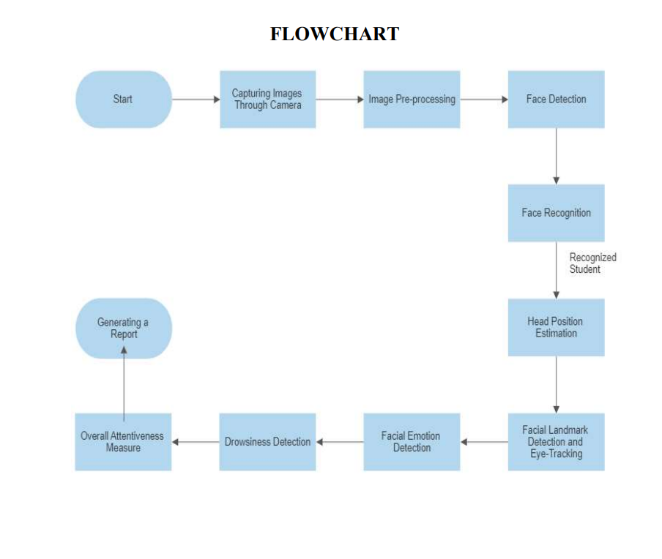

Slide 7

Take real Time video of Students

Slide 8

Image PreProcessing

Slide 9

Face Detection

Slide 10

Head Position Detection
Facial LandMark And Eye Tracking

Slide 11

Emotion Detection
Drowsiness Detection

Slide 12

OVERALL ATTENTIVENESS MEASURE

Slide 13

GENERATE REPORT

Slide 14

Conclusion

Slide 15

Report generated by this system shall be used to understand the pace of the class
Better monitoring capability
Improving quality of education and thereby performance of students

Slide 16

THANK YOU

